Slide 1
Java String
Java String :
In Java, string is basically an object that represents sequence of char values. An array of characters works same as Java string. For example:
char[] ch={'k','i','i','t'};
String s=new String(ch);
is same as:
String s="kiit";

Slide 2
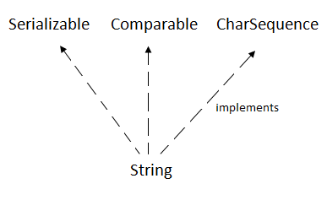
Java String
Java String :
Java String class provides a lot of methods to perform operations on string such as compare(), concat(), equals(), split(), length(), replace(), compareTo(), intern(), substring() etc.
The java.lang.String class implements Serializable, Comparable and CharSequence interfaces.

Slide 3
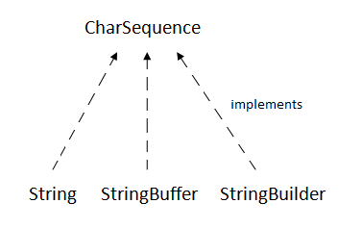
Java String
CharSequence Interface :
The CharSequence interface is used to represent the sequence of characters. String, StringBuffer and StringBuilder classes implement it. It means, we can create strings in java by using these three classes.

Slide 4
Java String
CharSequence Interface :
The Java String is immutable which means it cannot be changed. Whenever we change any string, a new instance is created. For mutable strings, you can use StringBuffer and StringBuilder classes.
We will discuss immutable string later. Let's first understand what is String in Java and how to create the String object.

Slide 5
Java String
How to create a string object ?
There are two ways to create String object:
By string literal
By new keyword

Slide 6
Java String
By string literal :
Java String literal is created by using double quotes. For Example:
String s="welcome";
Each time you create a string literal, the JVM checks the "string constant pool" first. If the string already exists in the pool, a reference to the pooled instance is returned. If the string doesn't exist in the pool, a new string instance is created and placed in the pool. For example:
String s1="Welcome";
String s2="Welcome";//It doesn't create a new instance

Slide 7
Java String
By string literal :
Java String literal is created by using double quotes. For Example:
String s="welcome";
Each time you create a string literal, the JVM checks the "string constant pool" first. If the string already exists in the pool, a reference to the pooled instance is returned. If the string doesn't exist in the pool, a new string instance is created and placed in the pool. For example:
String s1="Welcome";
String s2="Welcome";//It doesn't create a new instance

Slide 8
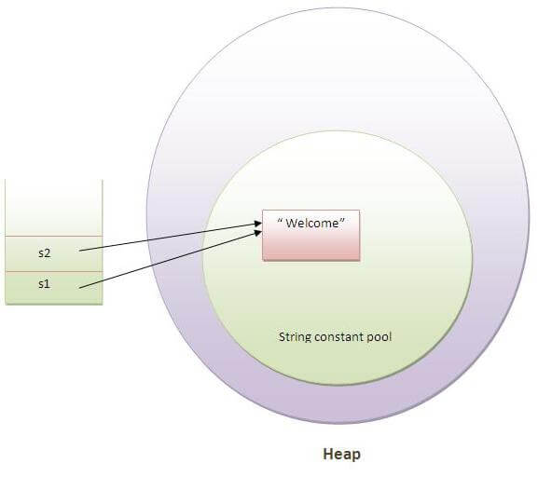
Java String
By string literal :
In the previous example, only one object will be created. Firstly, JVM will not find any string object with the value "Welcome" in string constant pool, that is why it will create a new object. After that it will find the string with the value "Welcome" in the pool, it will not create a new object but will return the reference to the same instance.
Note: String objects are stored in a special memory area known as the "string constant pool".

Slide 9
Java String
Why Java uses the concept of String literal ?
To make Java more memory efficient (because no new objects are created if it exists already in the string constant pool).

Slide 10
Java String
By new keyword :
String s=new String("Welcome");//creates two objects and one reference variable
In such case, JVM will create a new string object in normal (non-pool) heap memory, and the literal "Welcome" will be placed in the string constant pool. The variable s will refer to the object in a heap (non-pool).

Slide 11
Java String
Java String Example :
public class StringExample{
public static void main(String args[]){
String s1="java";//creating string by java string literal
char ch[]={'s','t','r','i','n','g','s'};
String s2=new String(ch);//converting char array to string
String s3=new String("example");//creating java string by new keyword
System.out.println(s1);
System.out.println(s2);
System.out.println(s3);
}}

Slide 12
Java String
Immutable String in Java :
In java, string objects are immutable. Immutable simply means unmodifiable or unchangeable.
Once string object is created its data or state can't be changed but a new string object is created.
class Testimmutablestring{
public static void main(String args[]){
String s="Sachin";
s.concat(" Tendulkar");//concat() method appends the string at the end
System.out.println(s);//will print Sachin because strings are immutable objects
}}

Slide 13
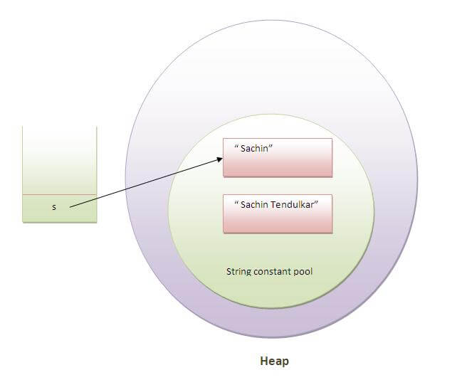
Java String
Immutable String in Java :
Now it can be understood by the diagram given below. Here Sachin is not changed but a new object is created with sachintendulkar. That is why string is known as immutable.

Slide 14
Java String
Immutable String in Java :
As you can see in the previous figure that two objects are created but s reference variable still refers to "Sachin" not to "Sachin Tendulkar".
But if we explicitely assign it to the reference variable, it will refer to "Sachin Tendulkar" object.

Slide 15
Java String
Immutable String in Java :
class Testimmutablestring1{
public static void main(String args[]){
String s="Sachin";
s=s.concat(" Tendulkar");
System.out.println(s);
}
}
Output:Sachin Tendulkar
In such case, s points to the "Sachin Tendulkar". Please notice that still sachin object is not modified.

Slide 16
Java String
Why string objects are immutable in java ?
Because java uses the concept of string literal.Suppose there are 5 reference variables,all referes to one object "sachin".If one reference variable changes the value of the object, it will be affected to all the reference variables. That is why string objects are immutable in java.

Slide 17
Java String
Java String compare :
We can compare string in java on the basis of content and reference.
It is used in authentication (by equals() method), sorting (by compareTo() method), reference matching (by == operator) etc.
There are three ways to compare string in java:
1. By equals() method
2. By = = operator
3. By compareTo() method

Slide 18
Java String
1) String compare by equals() method
The String equals() method compares the original content of the string. It compares values of string for equality. String class provides two methods:
public boolean equals(Object another) compares this string to the specified object.
public boolean equalsIgnoreCase(String another) compares this String to another string, ignoring case.

Slide 19
Java String
1) String compare by equals() method
class Teststringcomparison1{
public static void main(String args[]){
String s1="Sachin";
String s2="Sachin";
String s3=new String("Sachin");
String s4="Saurav";
System.out.println(s1.equals(s2));//true
System.out.println(s1.equals(s3));//true
System.out.println(s1.equals(s4));//false
}
}

Slide 20
Java String
1) String compare by equals() method
class Teststringcomparison2{
public static void main(String args[]){
String s1="Sachin";
String s2="SACHIN";
System.out.println(s1.equals(s2));//false
System.out.println(s1.equalsIgnoreCase(s2));//true
}
}

Slide 21
Java String
2) String compare by == operator
The = = operator compares references not values.
class Teststringcomparison3{
public static void main(String args[]){
String s1="Sachin";
String s2="Sachin";
String s3=new String("Sachin");
System.out.println(s1==s2);//true (because both refer to same instance)
System.out.println(s1==s3);//false(because s3 refers to instance created in nonpool)
}
}

Slide 22
Java String
3) String compare by compareTo() method
The String compareTo() method compares values lexicographically and returns an integer value that describes if first string is less than, equal to or greater than second string.
Suppose s1 and s2 are two string variables. If:
s1 == s2 :0
s1 > s2 :positive value
s1 < s2 :negative value

Slide 23
Java String
3) String compare by compareTo() method
class Teststringcomparison4{
public static void main(String args[]){
String s1="Sachin";
String s2="Sachin";
String s3="Ratan";
System.out.println(s1.compareTo(s2));//0
System.out.println(s1.compareTo(s3));//1(because s1>s3)
System.out.println(s3.compareTo(s1));//-1(because s3 < s1 )
}
}

Slide 24
Java String
String Concatenation in Java :
In java, string concatenation forms a new string that is the combination of multiple strings. There are two ways to concat string in java:
1. By + (string concatenation) operator
2.By concat() method

Slide 25
Java String
String Concatenation in Java :
In java, string concatenation forms a new string that is the combination of multiple strings. There are two ways to concat string in java:
1. By + (string concatenation) operator
2.By concat() method

Slide 26
Java String
1) String Concatenation by + (string concatenation) operator
class TestStringConcatenation1{
public static void main(String args[]){
String s="Sachin"+" Tendulkar";
System.out.println(s);//Sachin Tendulkar
}
}
The Java compiler transforms above code to this:
String s=(new StringBuilder()).append("Sachin").append(" Tendulkar).toString();

Slide 27
Java String
1) String Concatenation by + (string concatenation) operator
In java, String concatenation is implemented through the StringBuilder (or StringBuffer) class and its append method. String concatenation operator produces a new string by appending the second operand onto the end of the first operand. The string concatenation operator can concat not only string but primitive values also. For Example:
class TestStringConcatenation2{
public static void main(String args[]){
String s=50+30+"Sachin"+40+40;
System.out.println(s);//80Sachin4040
}}

Slide 28
Java String
2) String Concatenation by concat() method
The String concat() method concatenates the specified string to the end of current string. Syntax:
public String concat(String another)
class TestStringConcatenation3{
public static void main(String args[]){
String s1="Sachin ";
String s2="Tendulkar";
String s3=s1.concat(s2);
System.out.println(s3);//Sachin Tendulkar
}
}

Slide 29
Java String
Substring in Java :
A part of string is called substring. In other words, substring is a subset of another string. In case of substring startIndex is inclusive and endIndex is exclusive.
Note: Index starts from 0.
You can get substring from the given string object by one of the two methods:
public String substring(int startIndex): This method returns new String object containing the substring of the given string from specified startIndex (inclusive).

Slide 30
Java String
Substring in Java :
public String substring(int startIndex, int endIndex): This method returns new String object containing the substring of the given string from specified startIndex to endIndex.
In case of string:
startIndex: inclusive
endIndex: exclusive
String s="hello";
System.out.println(s.substring(0,2));//he
In the above substring, 0 points to h but 2 points to e (because end index is exclusive).

Slide 31
Java String
Example of java substring :
public class TestSubstring{
public static void main(String args[]){
String s="SachinTendulkar";
System.out.println(s.substring(6));//Tendulkar
System.out.println(s.substring(0,6));//Sachin
}
}

Slide 32
Java String
Java String class methods :
The java.lang.String class provides a lot of methods to work on string. By the help of these methods, we can perform operations on string such as trimming, concatenating, converting, comparing, replacing strings etc.
Java String is a powerful concept because everything is treated as a string if you submit any form in window based, web based or mobile application.

Slide 33
Java String
Java String toUpperCase() and toLowerCase() method
String s="Sachin";
System.out.println(s.toUpperCase());//SACHIN
System.out.println(s.toLowerCase());//sachin
System.out.println(s);//Sachin(no change in original)

Slide 34
Java String
Home Assignment :
1. Java String trim() method
2. Java String startsWith() and endsWith() method
3. Java String charAt() method
4. Java String length() method
5. Java String intern() method
6. Java String valueOf() method
7. Java String replace() method

Slide 35
Java String
Java StringBuffer class :
Java StringBuffer class is used to create mutable (modifiable) string. The StringBuffer class in java is same as String class except it is mutable i.e. it can be changed.
Note: Java StringBuffer class is thread-safe i.e. multiple threads cannot access it simultaneously. So it is safe and will result in an order.

Slide 36
Java String
Important Constructors of StringBuffer class :
Constructor | Description
StringBuffer() | creates an empty string buffer with the initial capacity of 16.
StringBuffer(String str) | creates a string buffer with the specified string.
StringBuffer(int capacity) | creates an empty string buffer with the specified capacity as length.

Slide 37
Java String
What is mutable string ?
A string that can be modified or changed is known as mutable string. StringBuffer and StringBuilder classes are used for creating mutable string.

Slide 38
Java String
Home Assignment :
1. StringBuffer append() method
2. StringBuffer insert() method
3. StringBuffer replace() method
4. StringBuffer delete() method
5. StringBuffer reverse() method
6. StringBuffer capacity() method
7. StringBuffer ensureCapacity() method

Slide 39
Java String
Java StringBuilder class :
Java StringBuilder class is used to create mutable (modifiable) string. The Java StringBuilder class is same as StringBuffer class except that it is non-synchronized. It is available since JDK 1.5.

Slide 40
Java String
Important Constructors of StringBuilder class
Constructor | Description
StringBuilder() | creates an empty string Builder with the initial capacity of 16.
StringBuilder(String str) | creates a string Builder with the specified string.
StringBuilder(int length) | creates an empty string Builder with the specified capacity as length.

Slide 41
Java String
Home Assignment :
1. StringBuilder append() method
2. StringBuilder insert() method
3. StringBuilder replace() method
4. StringBuilder delete() method
5. StringBuilder reverse() method
6. StringBuilder capacity() method
7. StringBuilder ensureCapacity() method

Slide 42
Java String
Difference between String and StringBuffer
No. | String | StringBuffer
1) | String class is immutable. | StringBuffer class is mutable.
2) | String is slow and consumes more memory when you concat too many strings because every time it creates new instance. | StringBuffer is fast and consumes less memory when you cancat strings.
3) | String class overrides the equals() method of Object class. So you can compare the contents of two strings by equals() method. | StringBuffer class doesn't override the equals() method of Object c

Slide 43
Java String
Performance Test of String and StringBuffer :
public class ConcatTest{
public static String concatWithString() {
String t = "Java";
for (int i=0; i<10000; i++){
t = t + "Tpoint";
}
return t; }
public static String concatWithStringBuffer(){
StringBuffer sb = new StringBuffer("Java");
for (int i=0; i<10000; i++){
sb.append("Tpoint");
}
return sb.toString();}

Slide 44
Java String
Performance Test of String and StringBuffer :
public static void main(String[] args){
long startTime = System.currentTimeMillis();
concatWithString();
System.out.println("Time taken by Concating with String: "+(System.currentTimeMillis()-startTime)+"ms");
startTime = System.currentTimeMillis();
concatWithStringBuffer();
System.out.println("Time taken by Concating with StringBuffer: "+(System.currentTimeMillis()-startTime)+"ms");
}
}
Time taken by Concating with String: 578ms
Time taken by Concating with StringBuffer: 0ms

Slide 45
Java String
String and StringBuffer HashCode Test
public class InstanceTest{
public static void main(String args[]){
System.out.println("Hashcode test of String:");
String str="java";
System.out.println(str.hashCode());
str=str+"tpoint";
System.out.println(str.hashCode());

Slide 46
Java String
String and StringBuffer HashCode Test
System.out.println("Hashcode test of StringBuffer:");
StringBuffer sb=new StringBuffer("java");
System.out.println(sb.hashCode());
sb.append("tpoint");
System.out.println(sb.hashCode());
}
}
Hashcode test of String:
3254818
229541438
Hashcode test of StringBuffer:
118352462
118352462

Slide 47
Java String
Difference between StringBuffer and StringBuilder
No. | StringBuffer | StringBuilder
1) | StringBuffer is synchronized i.e. thread safe. It means two threads can't call the methods of StringBuffer simultaneously. | StringBuilder is non-synchronized i.e. not thread safe. It means two threads can call the methods of StringBuilder simultaneously.
2) | StringBuffer is less efficient than StringBuilder. | StringBuilder is more efficient than StringBuffer

